Slide 1
Building Event-Driven Applications
With TriggerMesh
Last updated May 31, 2022

Slide 2

https://github.com/JeffNeff/SCALE-Talk-Notes

Slide 3
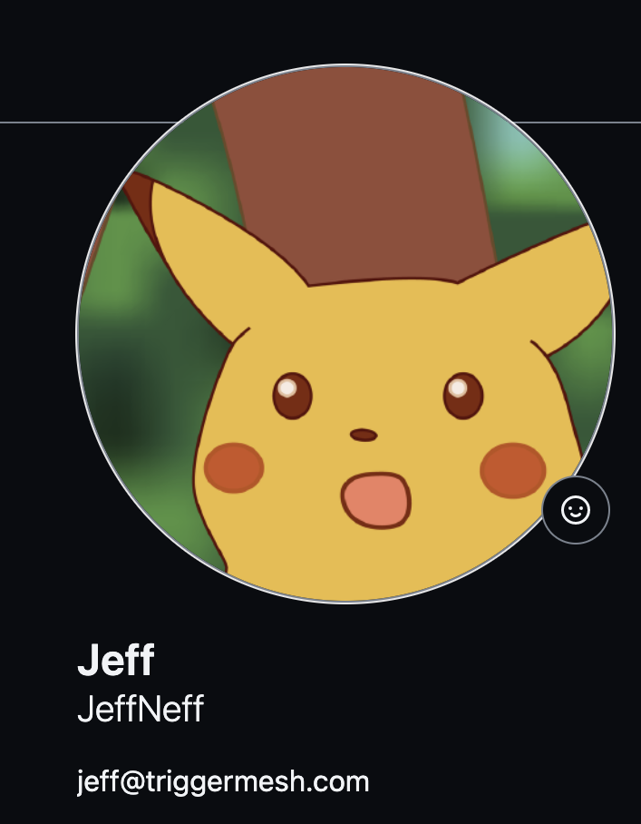
About Me
Name: Jeff Neff Title: Software Engineer @ Triggermesh Hobbies: - Competitive FPS Games
- Decentralized Technology/Web3 Stuffs - Traveling - High Performance Automobiles
Last updated May 31, 2022

Slide 4
What Is Triggermesh?

Slide 5
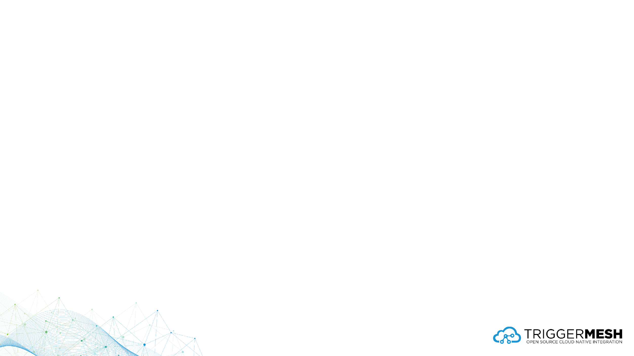
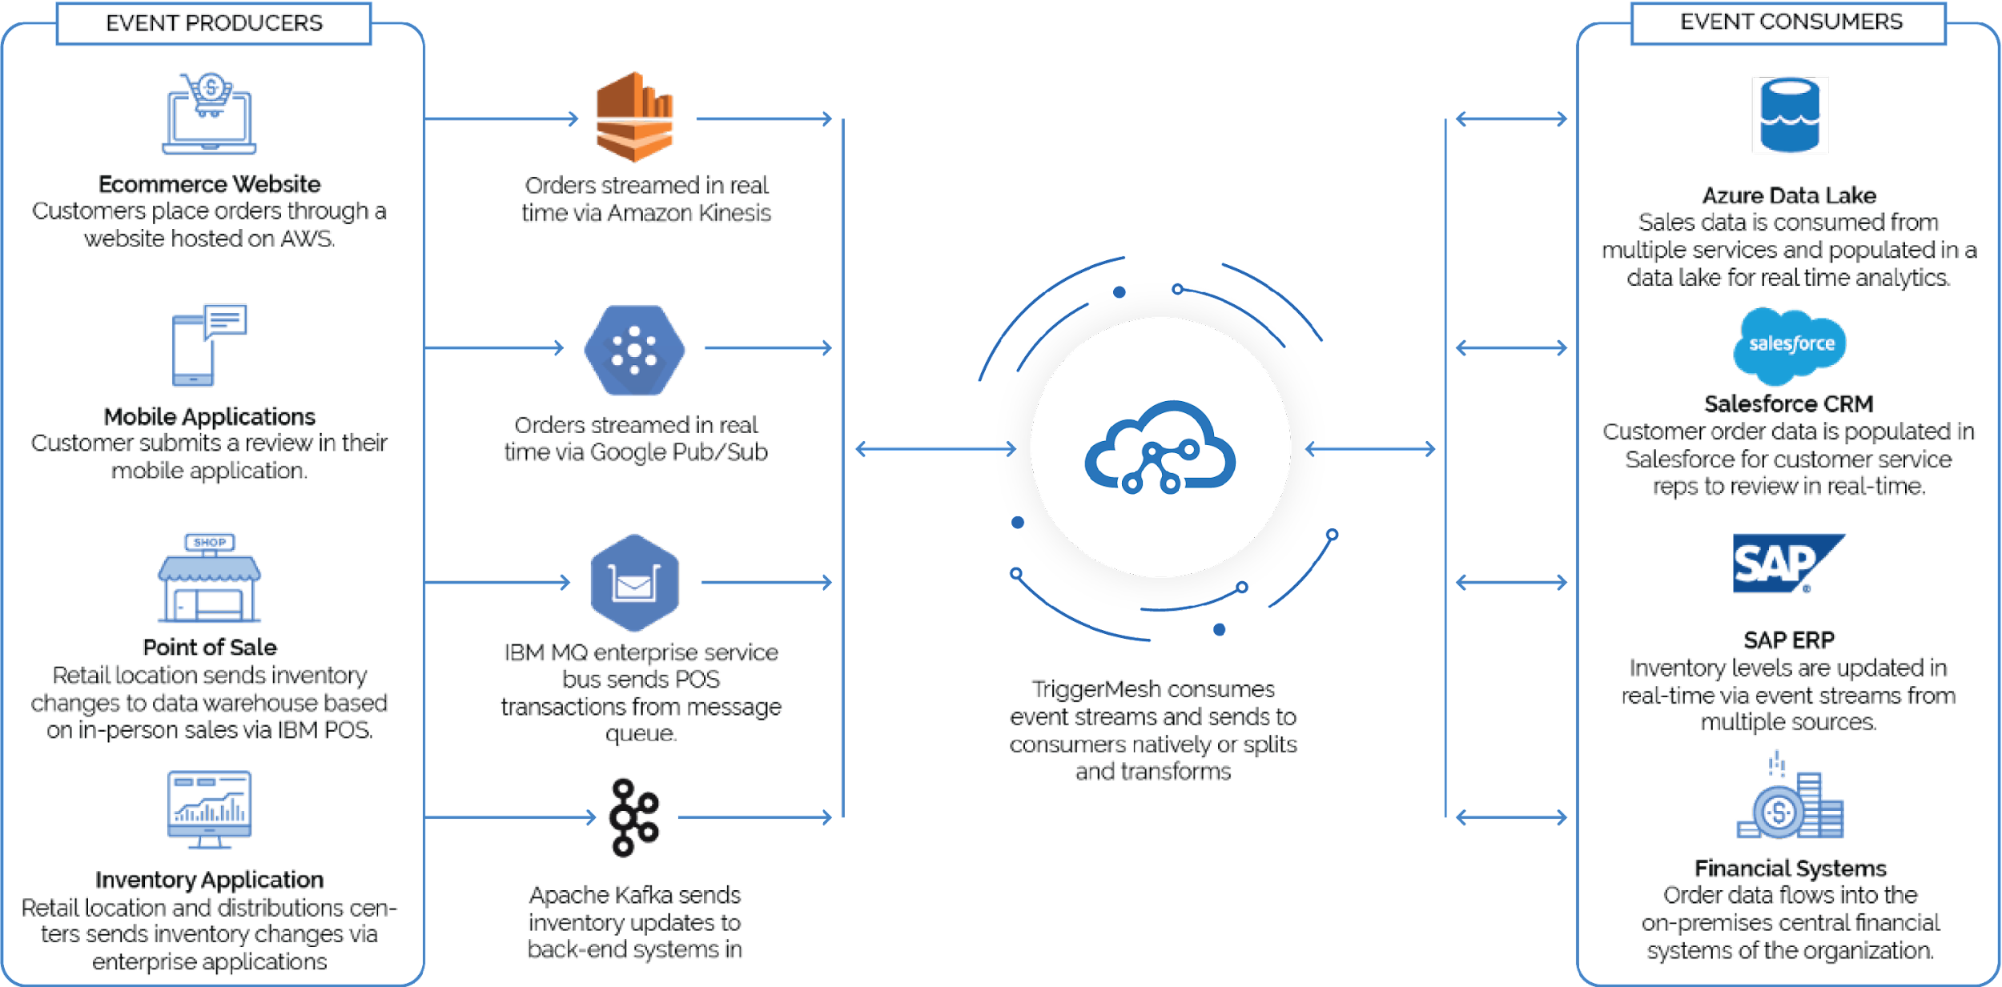
One Integration Platform for Everything
Cloud native for all your cloud and legacy infrastructure

Slide 6
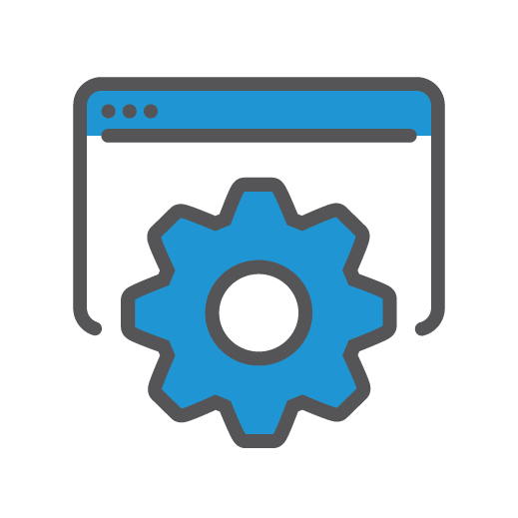
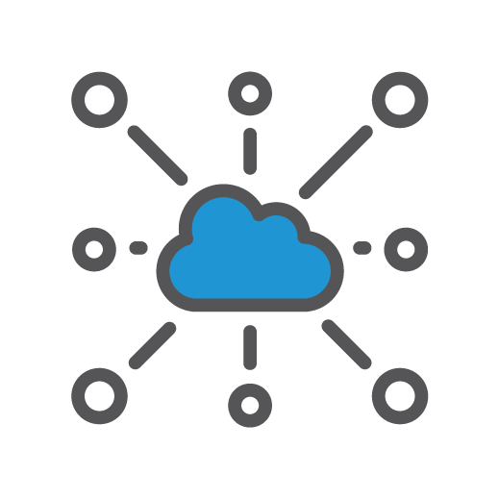
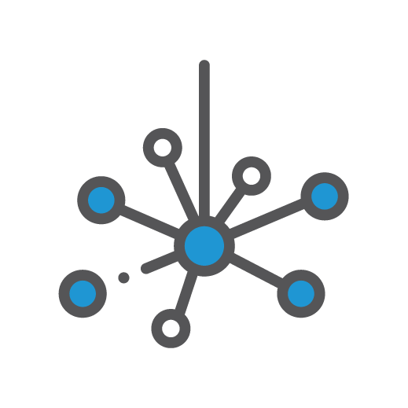
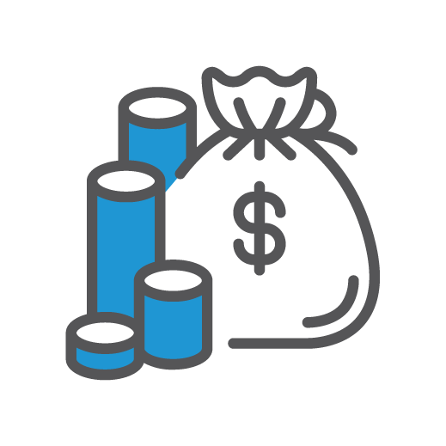
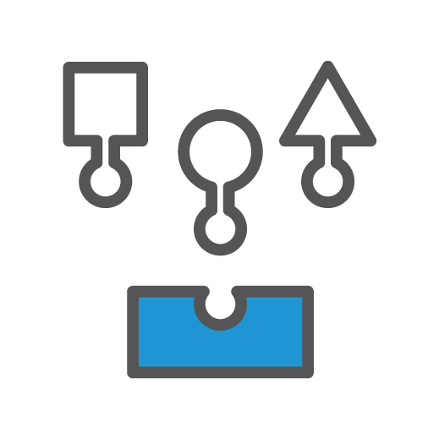

TriggerMesh Advantages
Extensible, cloud-native, open source, devops-friendly, multicloud
TriggerMesh is the best way to integrate cloud services and on-premises applications.
Declarative API for DevOps and GitOps cloud operators, low code visual editor for less technical users.
Architecture agnostic, allowing for multicloud, hybrid cloud, and on-premises applications.
Modern architecture built on technology that will be relevant for the foreseeable future (e.g. Kubernetes).
Self-service mindset allows users to deploy without expensive consultants, SAAS model reduces upfront expenditures.
Extensible via a plug-in architecture that can be extended by TriggerMesh or open source contributors.
Leveraging open source software from Google and others to bring products to market faster.

Slide 7
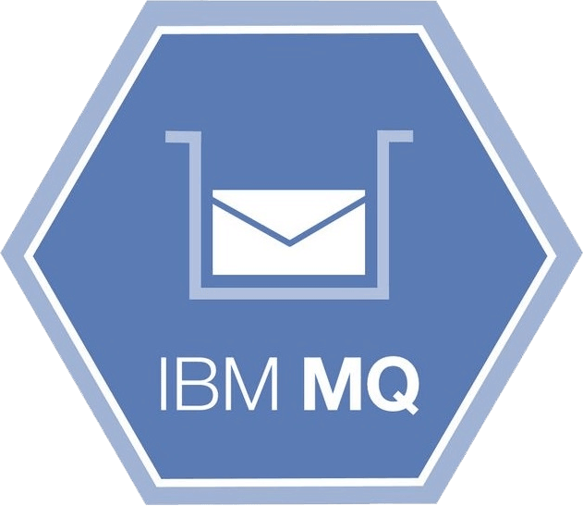
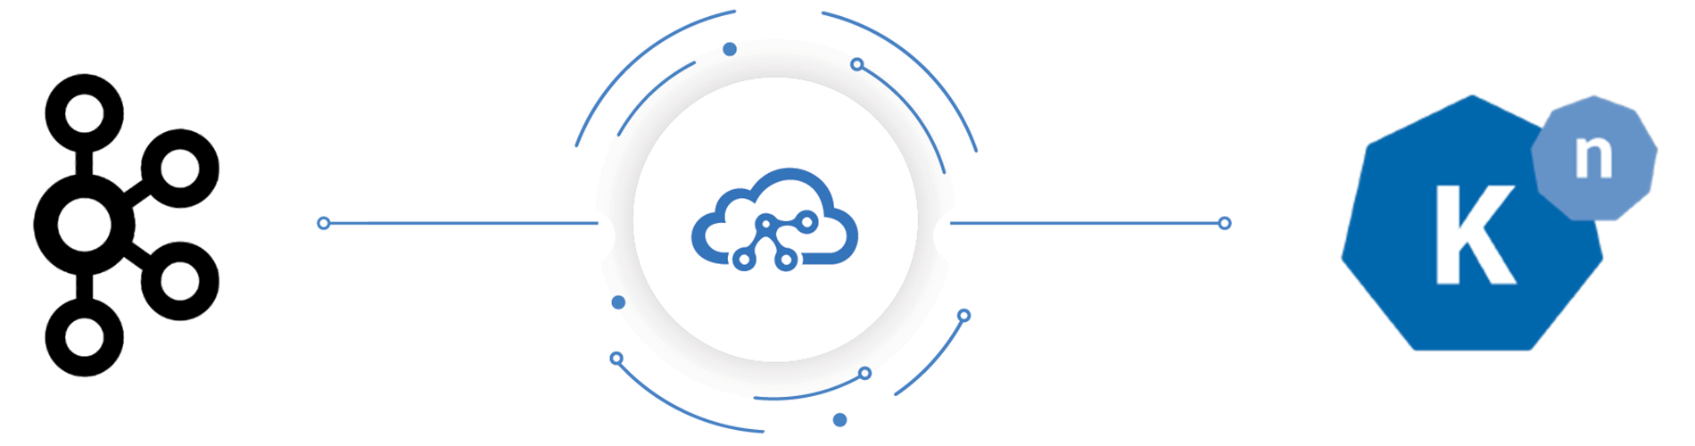

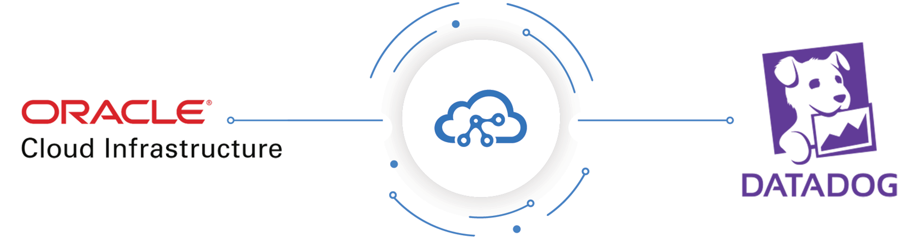
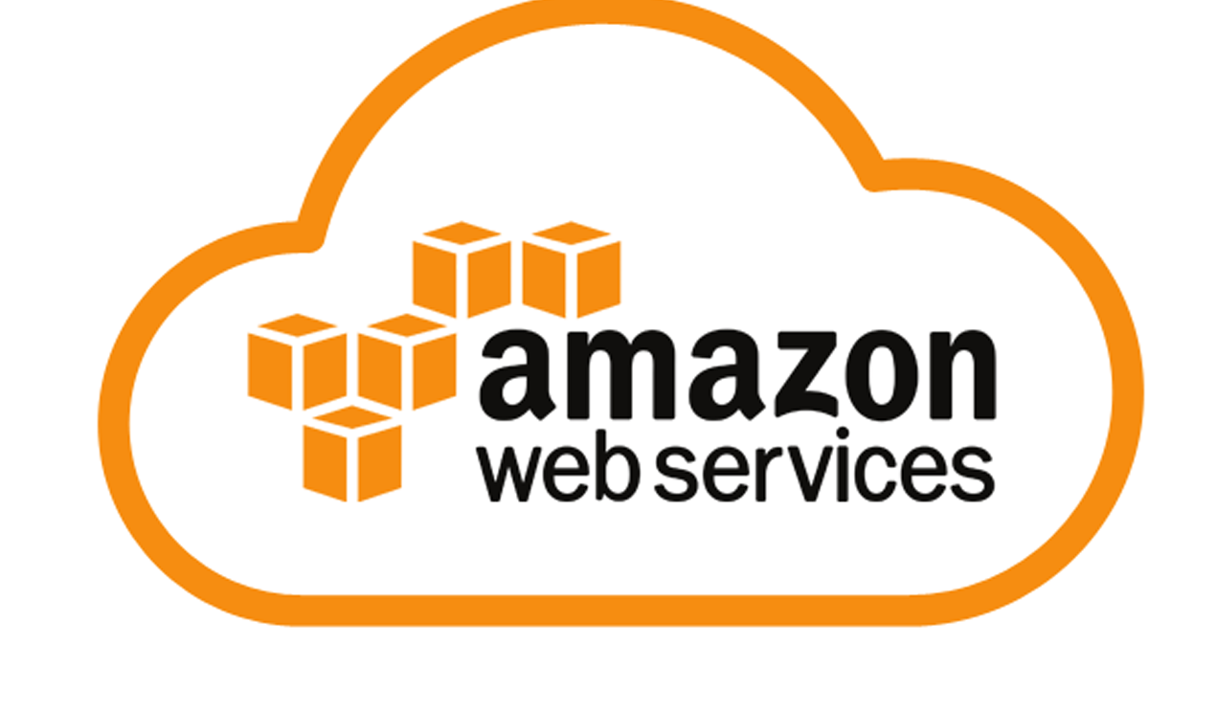
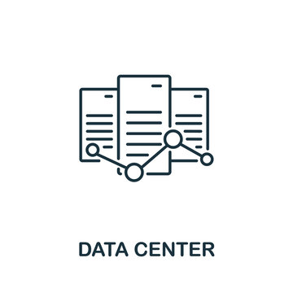


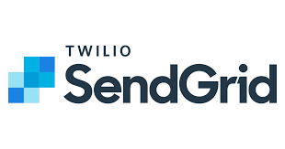
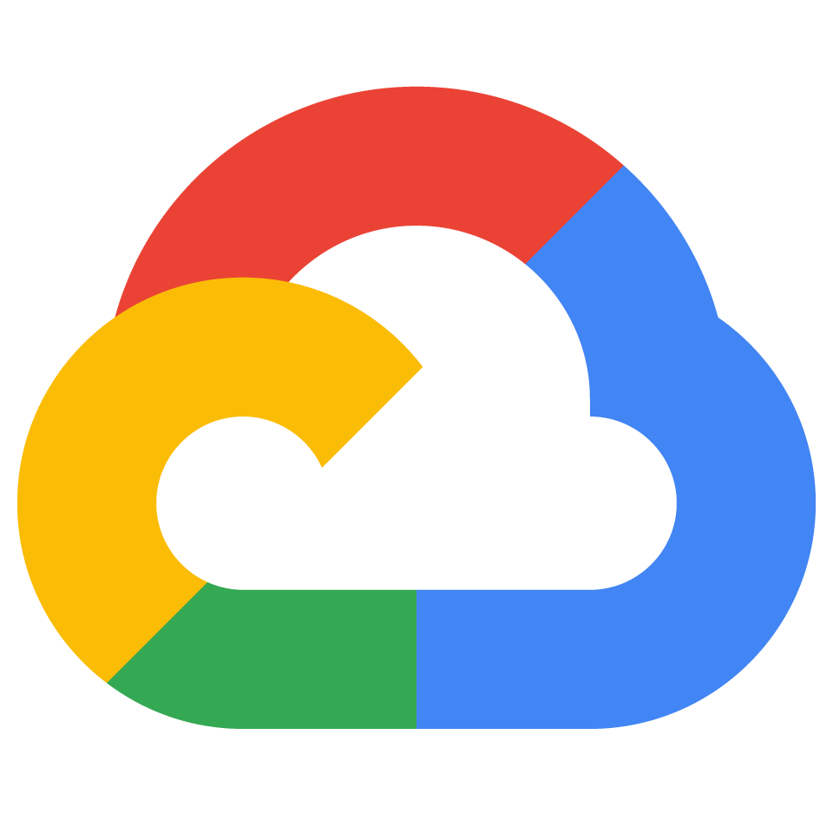

What can you do with TriggerMesh?
Save hundreds of thousands of dollars & improve business agility
Modernize Event Service Buses
Bridge mainframe-centric IBM MQ (or Tibco) to the cloud.
Reduce Integration Costs
Cap costs of expensive proprietary integration platforms (e.g. Mulesoft).
Stream Data between Clouds
Stream cloud metrics from Oracle Cloud Infrastructure to Datadog.
Improve Operations, Normalize Security Data
Create an Event-Mesh that speeds reaction to changing security conditions.
Create Real-Time Alerts
Send real-time alerts for shipping of ATM and credit card replacements
Run Serverless On-premises
Create a function-as-a-service environment on prem similar to AWS Lambda.
Notes:
You can modernize your existing enterprise service bus and integrate it to the cloud. We helped the an international car rental company.
You can cap your integration costs as we did by helping a $120 billion dollar international bank do this year as they moved off Mulesoft owned by Salesforce.
You can stream data between clouds as we did for Adenza, an international financial risk management company, that was Oracle’s largest SMB deal last year.
We can reduce the burden of ETL and speed data replication between legacy systems and new cloud based data warehouses
You can run severless on premises like we have been doing with PNC Bank for two years.

Slide 8
How Does Triggermesh Work
The basic building blocks for a Triggermesh integration, or Bridge, are :
Sources
Targets
Data Transformations
Brokers
Triggers
Filters
Splitters
Synchronizer
Custom Services
Functions

Slide 9
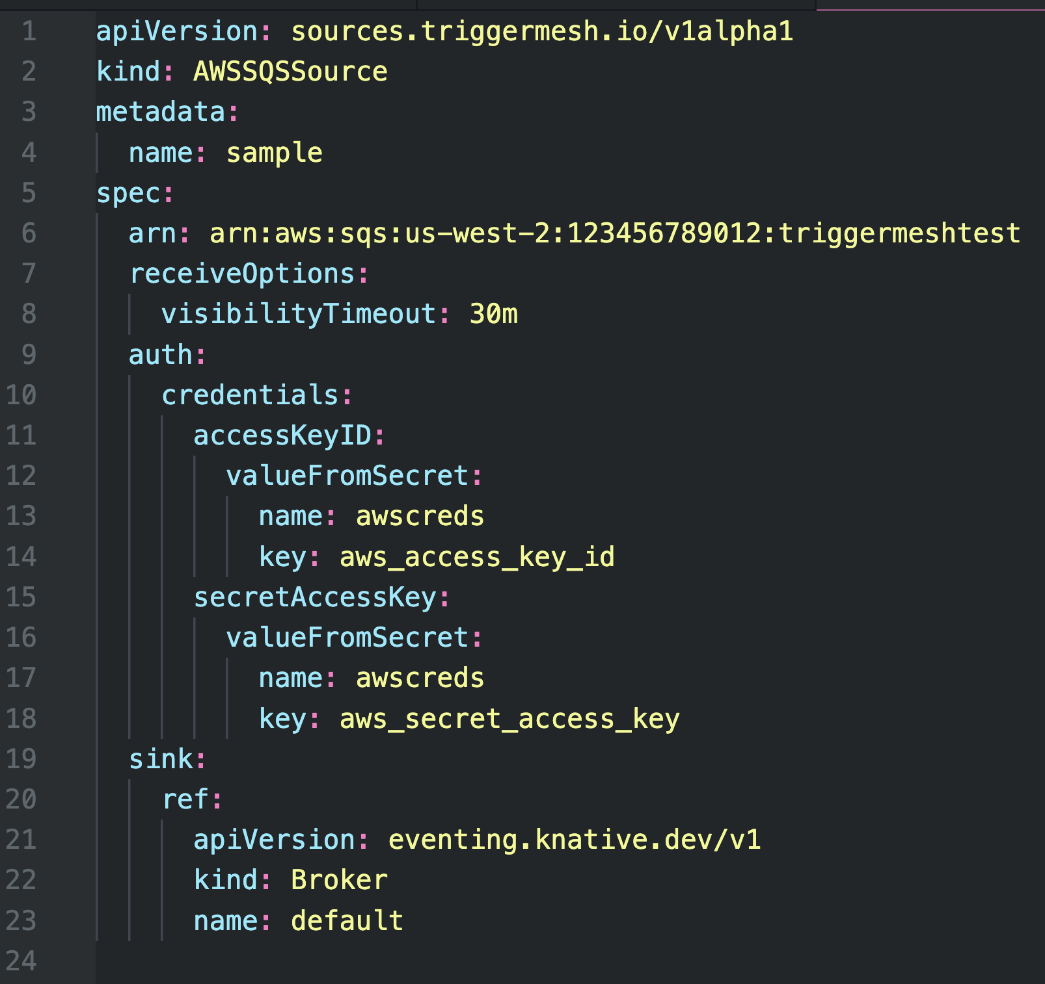
What is a Source ?
A Source is a component that generates events. Here we have an example of a Triggermesh AWS SQS Source.

Slide 10
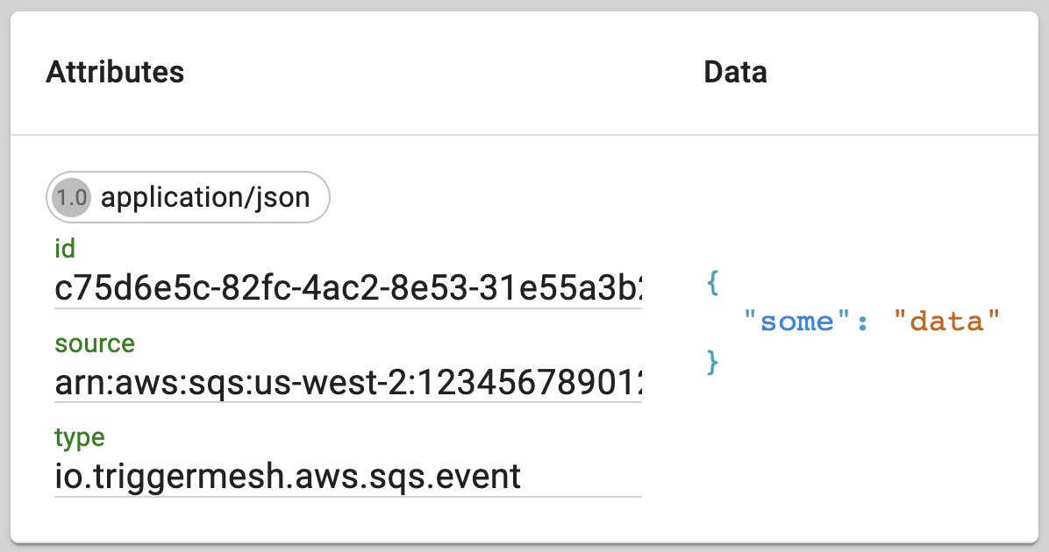
What Does it Create?
A Source component emits Cloudevents. Cloudevents are nothing more then Http(s) requests that contain some special header parameters.
Cloudevents is a specification from the serverless working group in CNCF ( Cloud Native Computing Foundation)

Slide 11
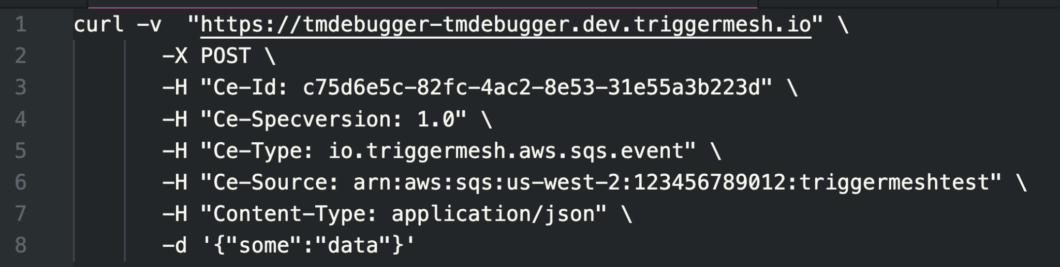
For the Nerds

Slide 12
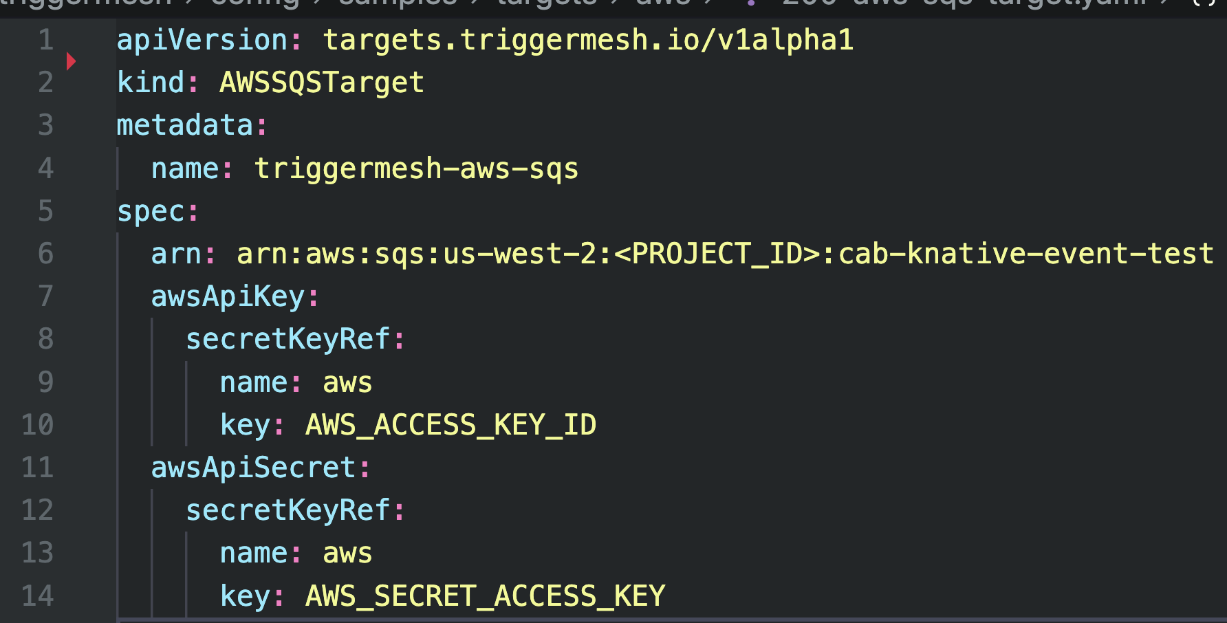
What is a Target ?
A Target is a component that consumes events. Here we have an example of a Triggermesh AWS SQS Target.

Slide 13
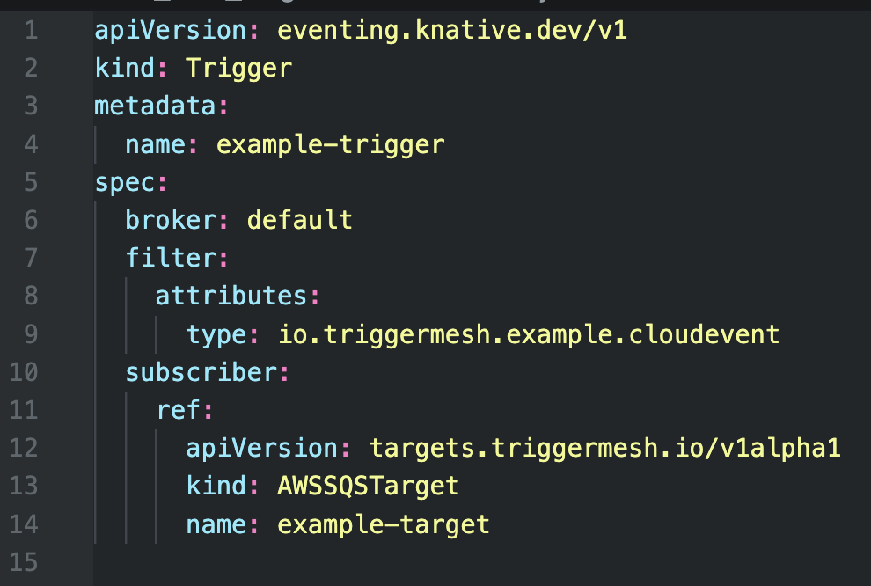
What is a Trigger ?
A Trigger is an interface that enables the user to tell the Broker “who wants what events” Here we have an example of a Trigger subscribing the AWS SQS Target to events that have events of type “io.triggermesh.example.cloudevent” from Broker named “default”

Slide 14
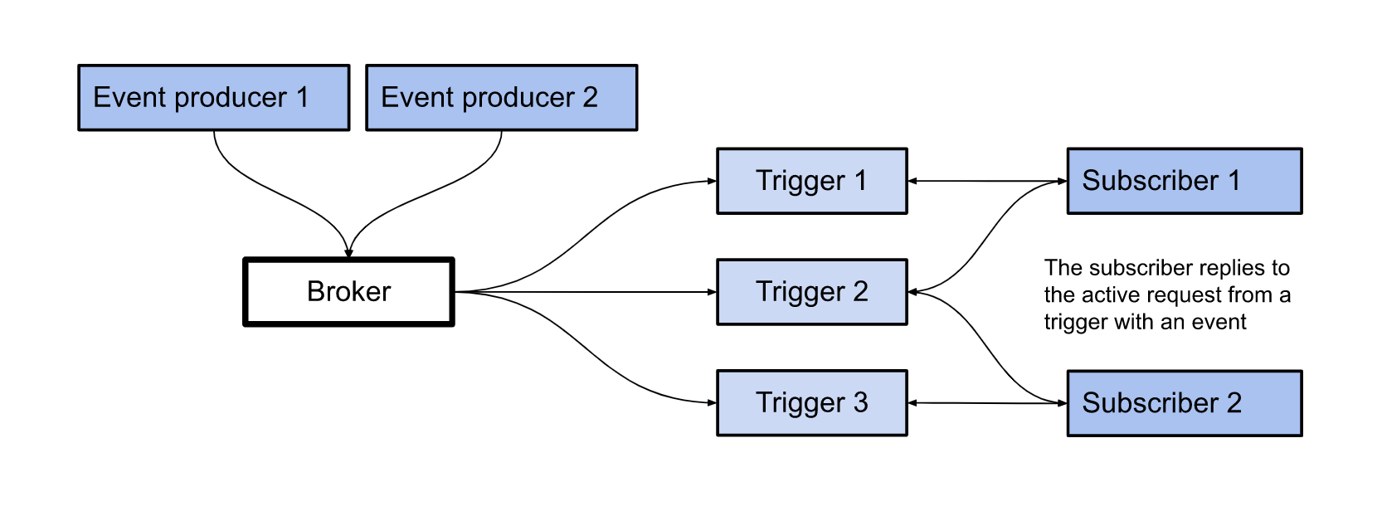
What is a Broker ?
Brokers are Kubernetes custom resources that define an event mesh for collecting a pool of CloudEvents. Brokers provide a discoverable endpoint, status.address, for event ingress, and triggers for event delivery.
Event producers can send events to a broker by POSTing the event to the status.address.url of the broker. TLDR; It’s an Event Delivery Transport

Slide 15
Data Transformation
Triggermesh components make the majority of data transformation scenarios easy by providing both function based components, in your favorite language, and declarative language components in order to accomplish this.

Slide 16
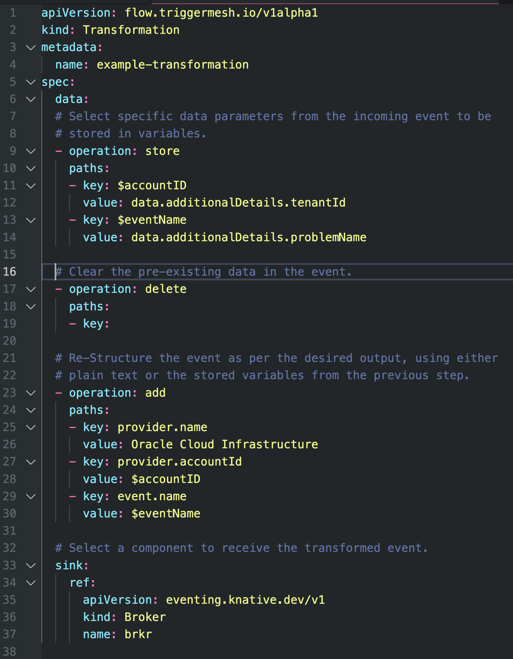
Declarative
Transformation
Component

Slide 17
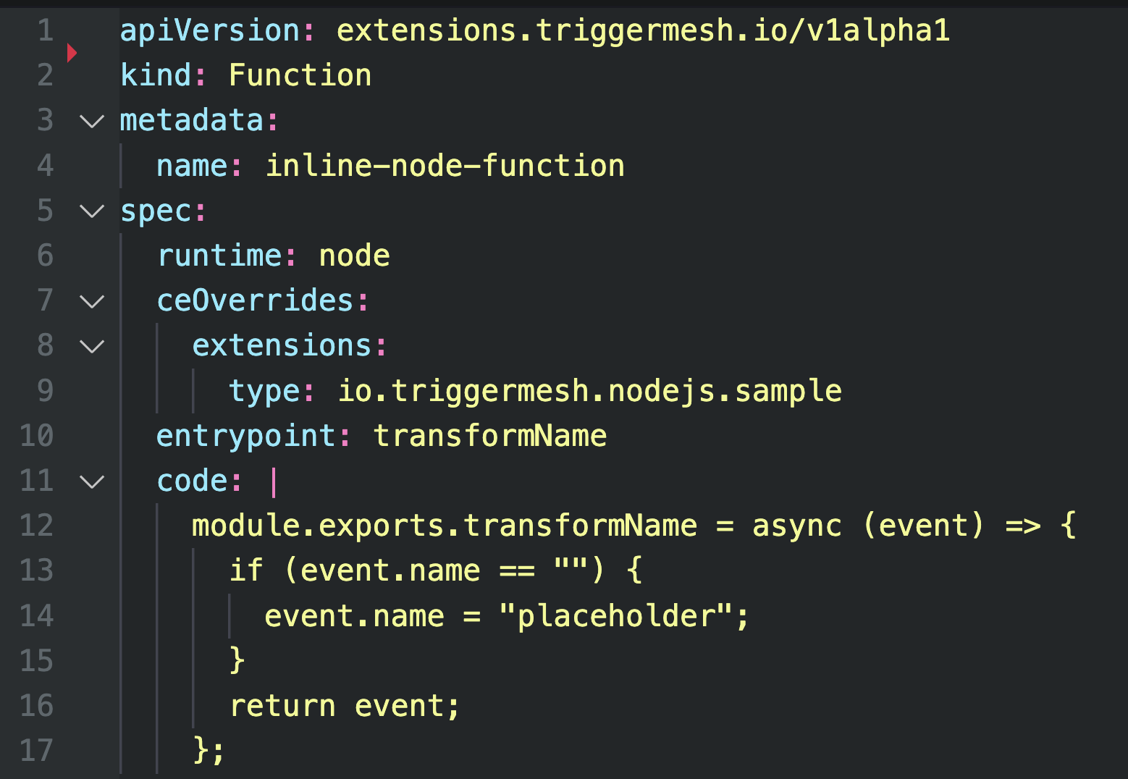
Function Based
Transformation
Component

Slide 18
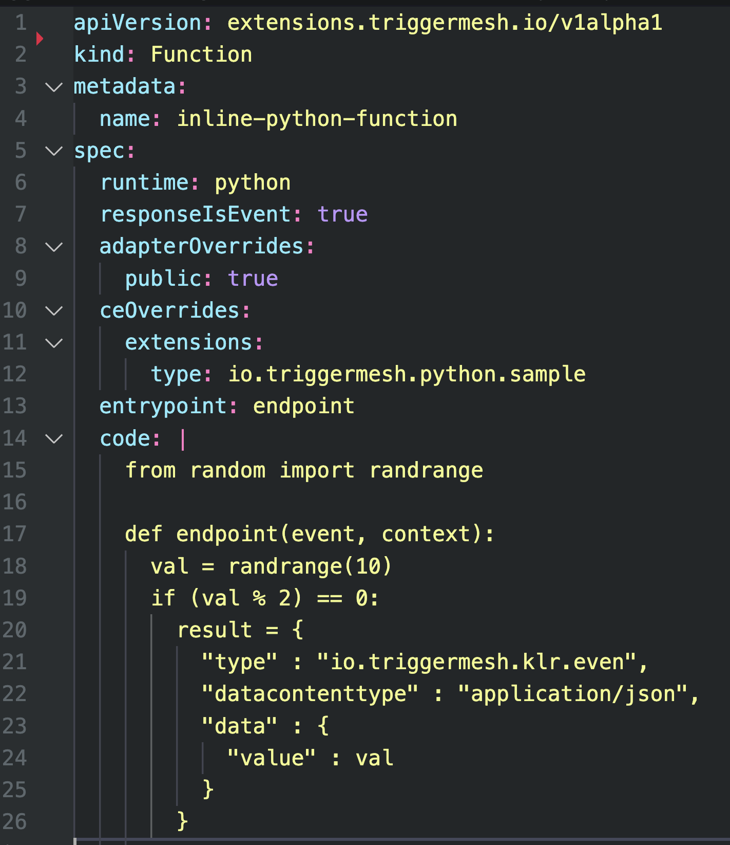
Function Based
Transformation
Component

Slide 19
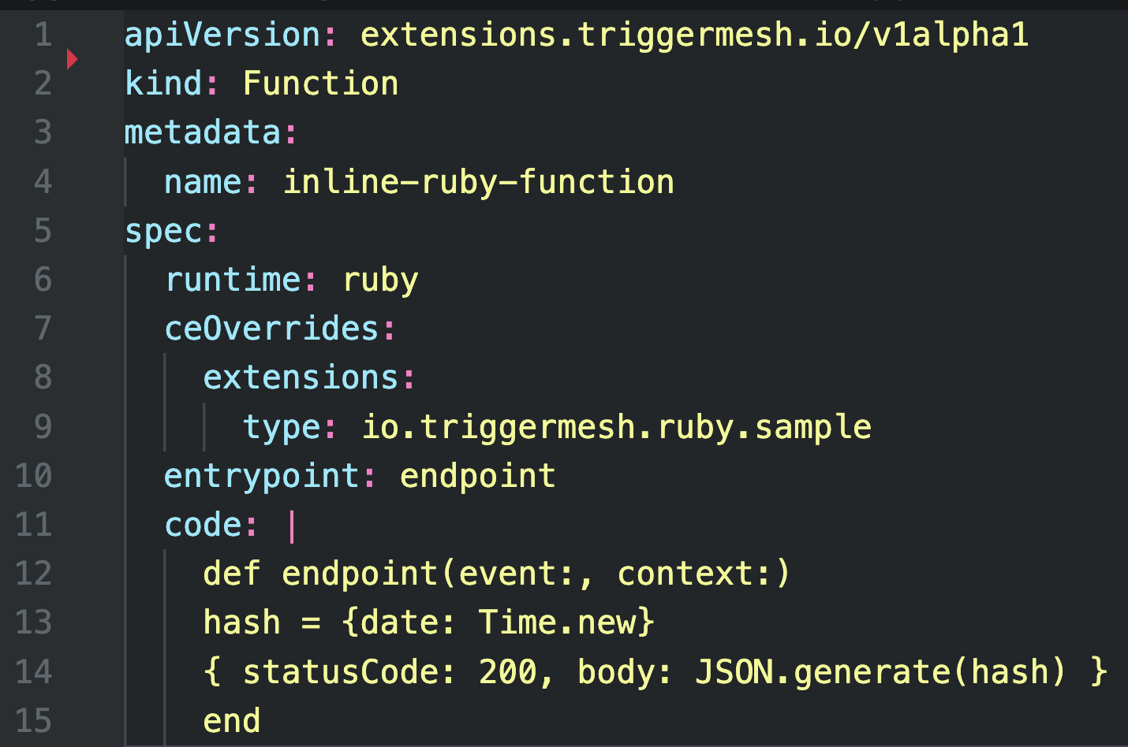
Function Based
Transformation
Component

Slide 20
Custom Services
Triggermesh makes it easy to integrate your own logic and runtimes in your language of choice. Any system or language that can accept/emit HTTP requests and can be containerized, can run on Triggermesh
In tech preview we have a meta controller to transform containers into API objects. ( Koby )

Slide 21
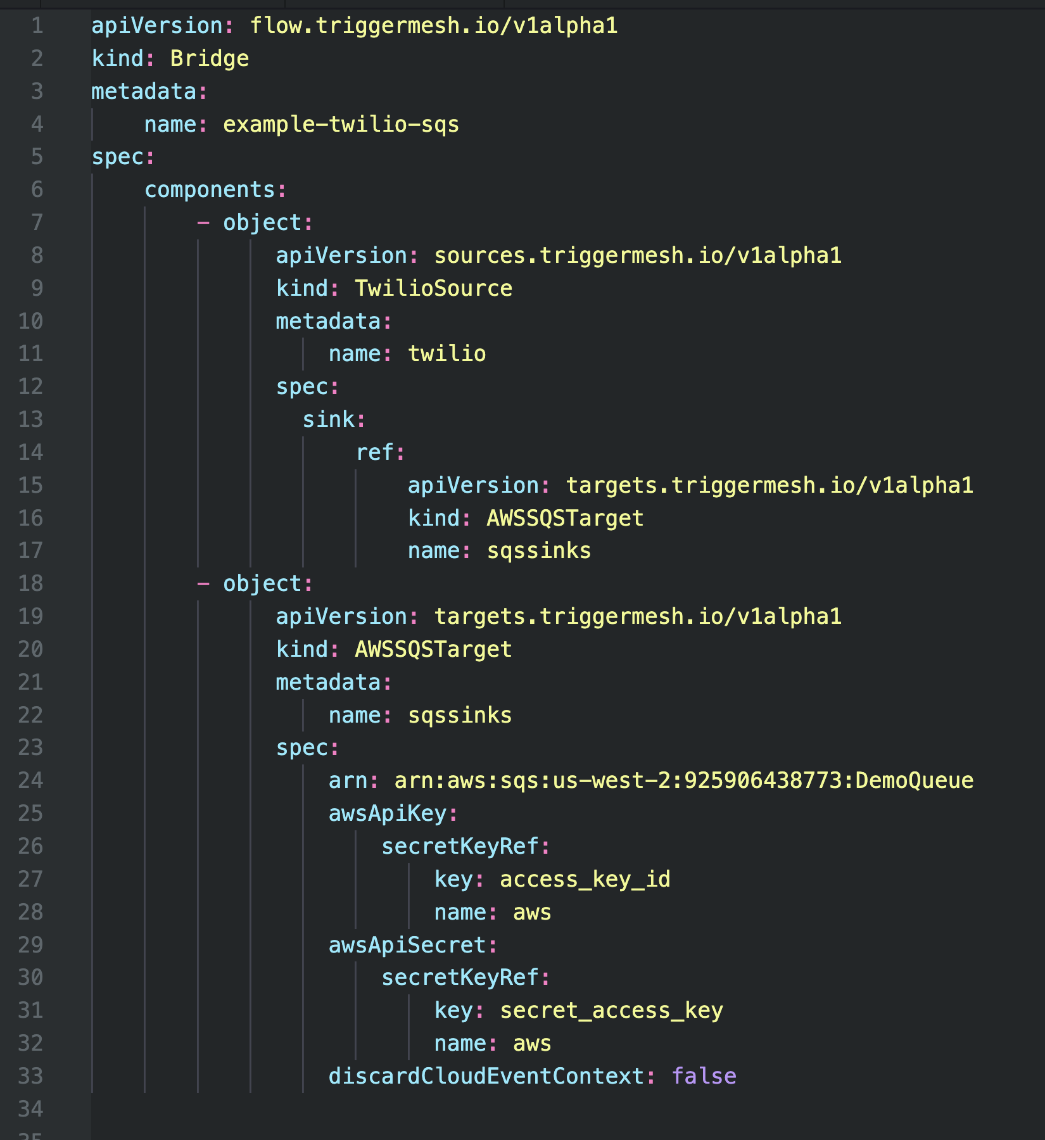
What is a Bridge?
A Bridge is a YAML manifest containing a combination of Triggermesh components. Here we have an example bridge containing a Twilio Source sending events to an AWS SQS Target

Slide 22
Case Study

Slide 23
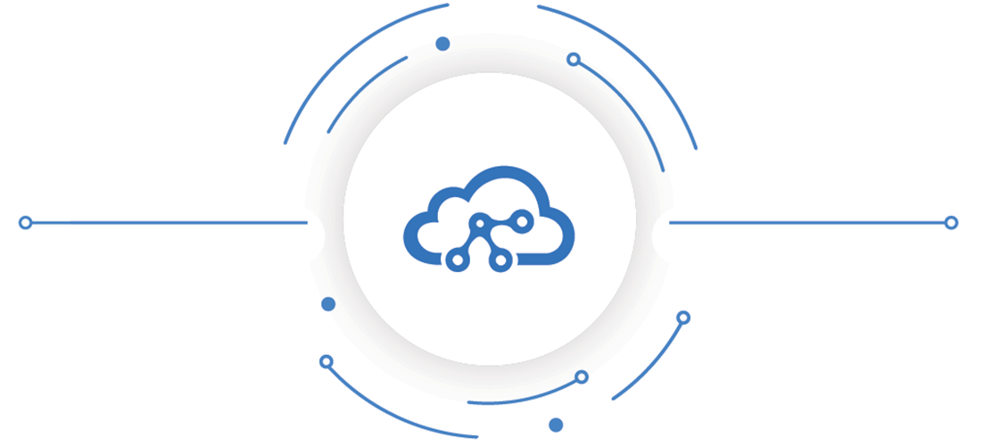
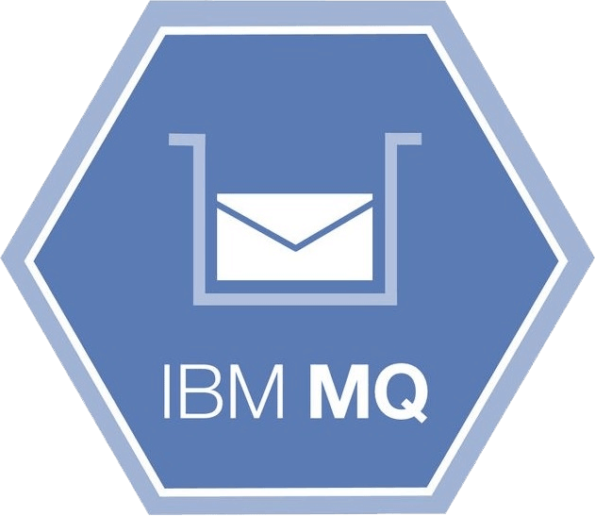
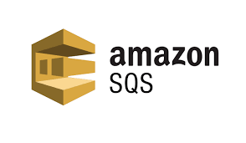
Case Study
Global Car Rental Company Modernizes IBM MQ with Cloud Native Integration
Extend the life of your mainframe while bringing it to the cloud
Problem: Legacy mainframe is critical operations but need to get data to the Amazon Web Services S3 Cloud
Solution: TriggerMesh provided a way to integrate IBM MQ with Amazon S3 by creating a integration that takes IBM Copybooks and maps them to an Amazon SQS queue.

Slide 24
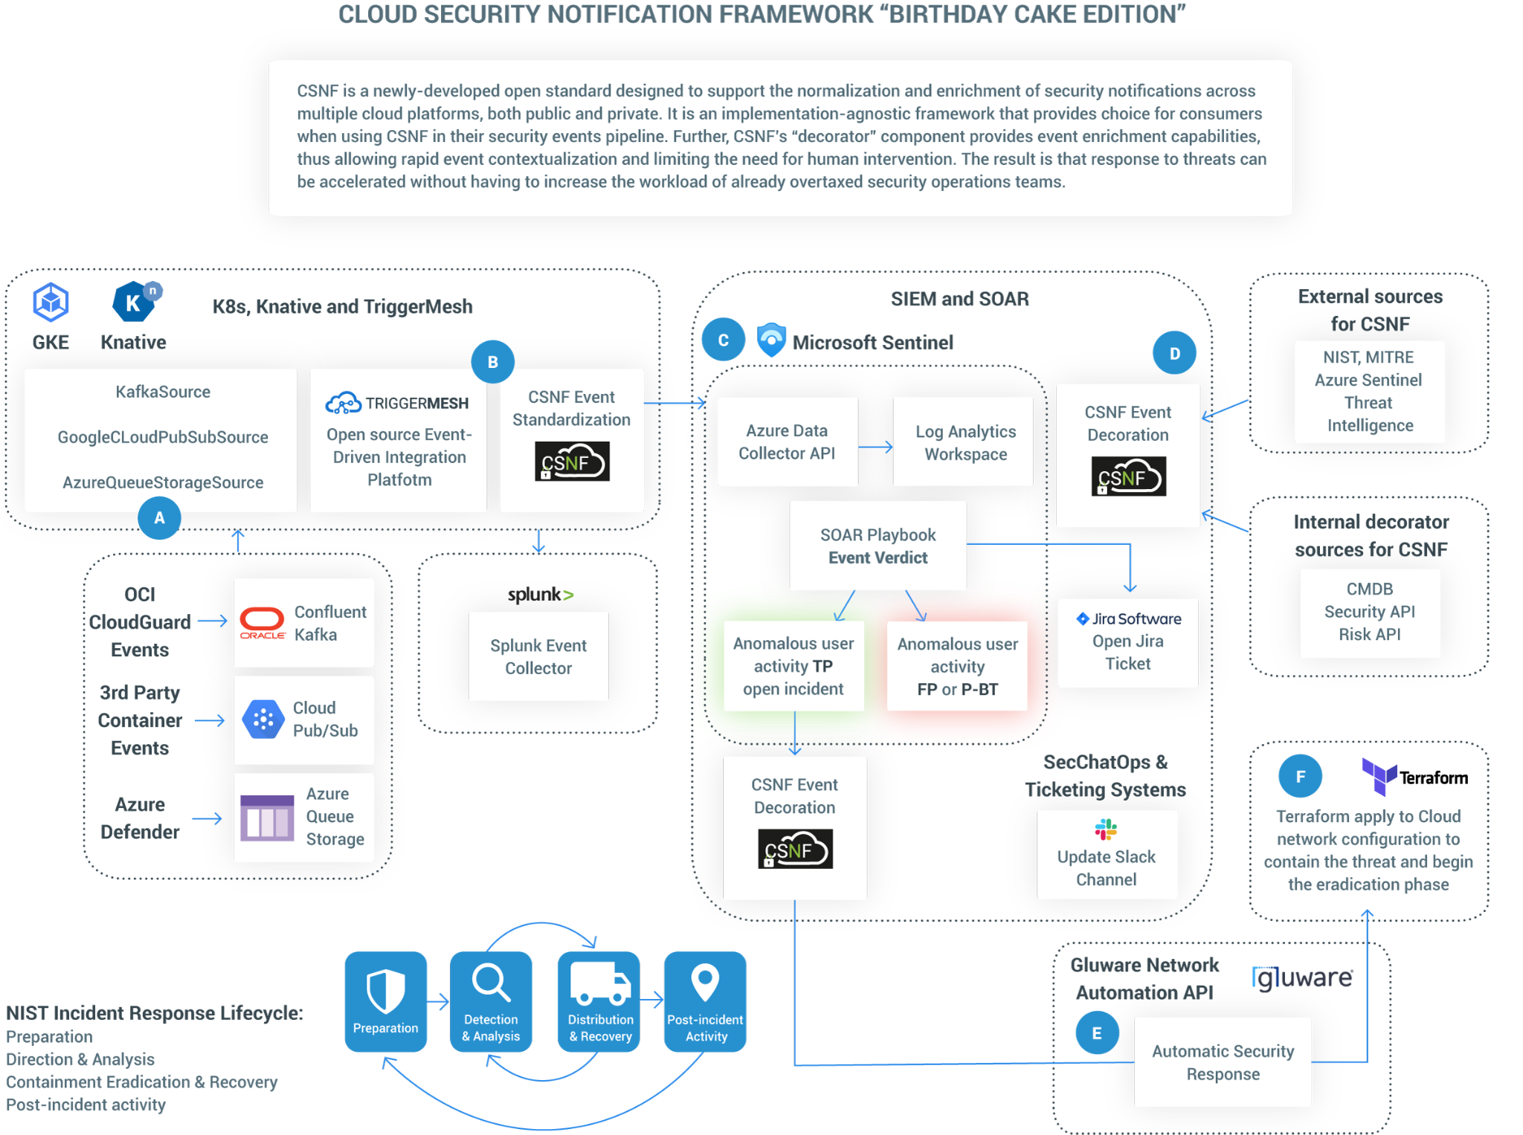









Case Study Cloud Security Notification Framework Co-Developed with Cigna
Reduce burden on your Security Operations Center (SOC) and respond to security events more quickly
Problem: Organizations need an open, interchangeable, software-defined solutions at every level of a business application dependency map including their governance policies.
Solution: This graphic illustrates the functional reference architecture for the implementation of an Enterprise Governance Policy based on the principles and goals outlined by the ACG Working Groupplemented an event-driven architecture leveraging serverless functions to automate processes formally performed by administrative personnel. Events from multiple different source applications trigger their Policy as Code (PaC) daemon and the outputs are automatically routed to Kafka for evaluation and notarization.
ONUG Membership
Source: ONUG ACG Working Group

Slide 25
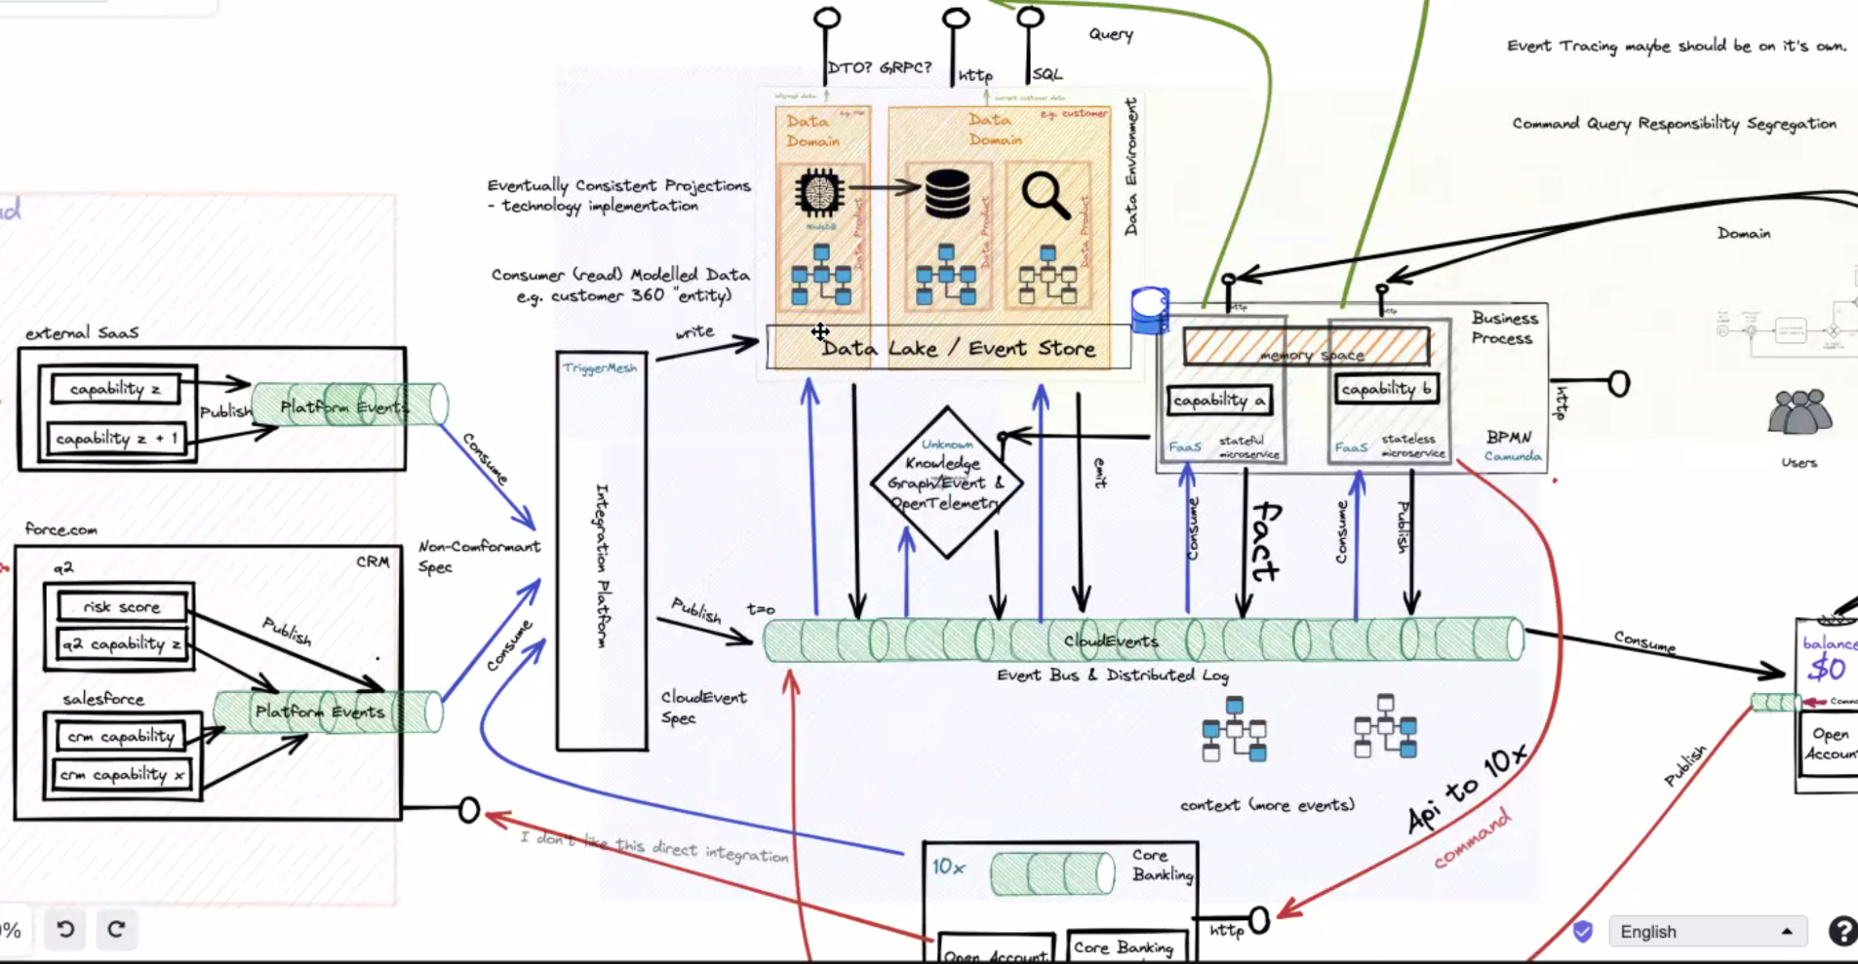

Case Study Constantinople Bank Creating Modern Fintech in the Cloud
Building a next-generation cloud native banking platform
Problem: Constantinople needed to build modern banking architecture for the banking industry that integrates multiple 3rd-party SaaS providers including 10X and Force.com. Hiring talent has been a problem so they need to accelerate hiring or improve productivity of existing employees.
Solution: Using TriggerMesh as an integration platform they are able to incorporate over 180 Event Streams from 10x Cloud Native Banking platforms. Additionally they had a standardized way to incorporate integrations with all their infrastructure including Salesforce, Data Lakes, and other 3rd Party SaaS platforms both directly and through cloud streaming technologies including Apache Kafka.

Slide 26
Lets Play 🥳

Slide 27




Get The Notes
HQ RTP, NC, USA
European HQ Geneva, CH
www.triggermesh.com
@triggermesh
info@triggermesh.com
919 678 1559

